Slide 1

GROUP ONE
AFRICAN TELECOMMUNICATIONS COMPANY
CAPSTONE PROJECT
AUGUST 31, 2024

Slide 2




Table Of Contents
01
Problem Statement
02
Project Aim
03
Project Roadmap
04
Model Selection (Base model and Adopted model)
05
KPIs
06
Deployment
10
07
Conclusion

Slide 3





PROBLEM STATEMENT
In the competitive telecommunications industry, customer churn - where customers become inactive and stop purchasing services - is a significant challenge. An African telecommunications service company is particularly concerned about customers ceasing to purchase airtime and data bundles.
This project aims to develop a machine learning model to predict the likelihood of customer churn, helping the company to proactively retain its customer base.

Slide 4

The primary aim of this project is to build a predictive model that assesses the likelihood of customers becoming inactive and discontinuing their purchase of airtime and data after a period of 90 days.
PROJECT AIM
By leveraging customer data, the model will identify customers at risk of churning. Enabling the company to implement target retention strategies and interventions.

Slide 5
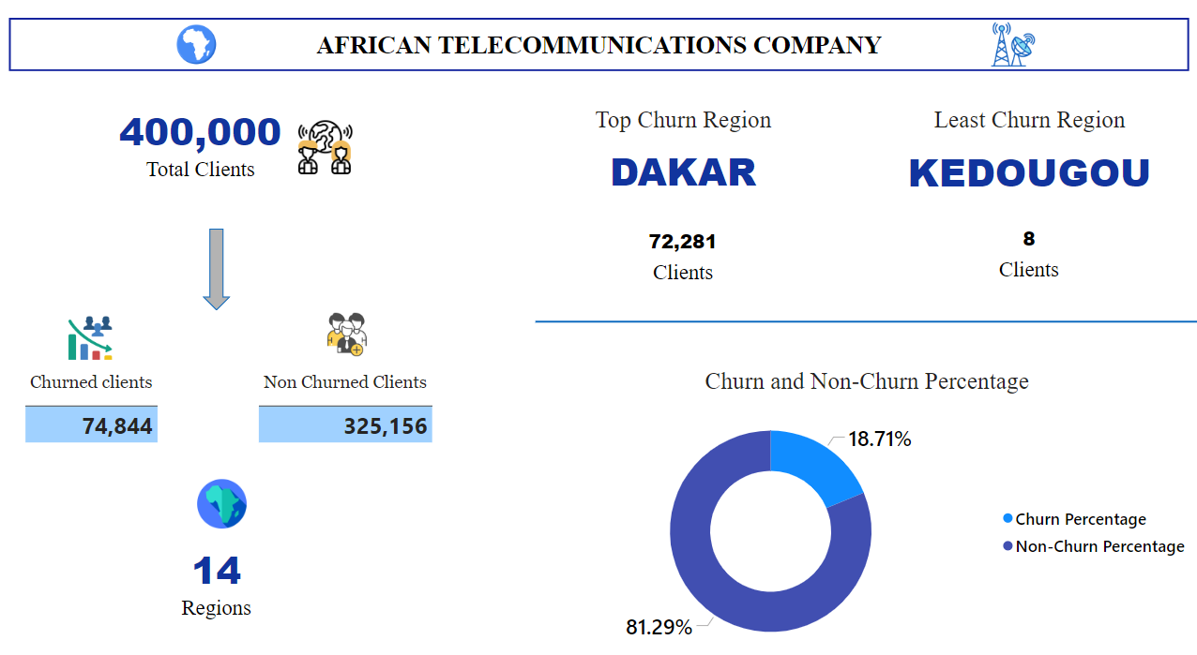

Slide 6
PROJECT ROADMAP

Slide 7




















Project Roadmap
06
Data Loading and Inspection
Data Preprocessing and Feature Engineering
05
Reading data
Data shape
Summary statistics
Tenure mapping
Label encoding
Balancing classes
defining features and Targets
04
Data Cleaning
Model Training and Evaluation
Dropping irrelevant features
Handling missing values
Defining categorical and numerical features
Logistics regression
Decision Tree model
RandomForest Classifier
XGBOOST
Gradient Boosting Classifier
03
02
Visualizations
Model Deployment
Distribution of columns
Correlation heatmap
Churn Distribution
Adopted Model - XGBoost refactored
Streamlit
01

Slide 8
MODEL SELECTION

Slide 9

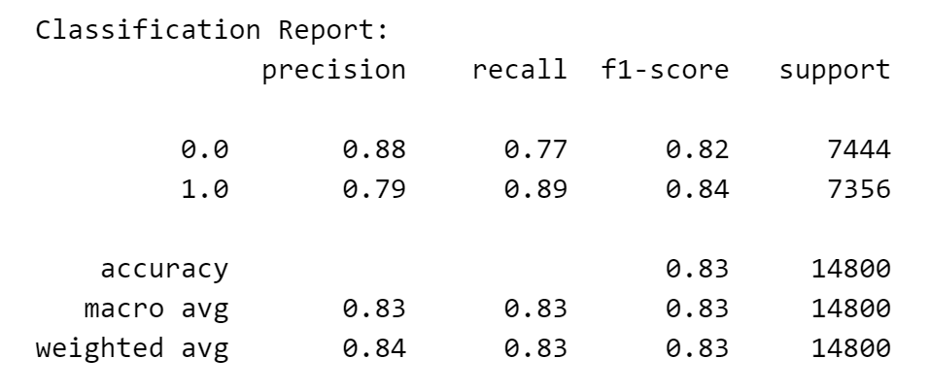
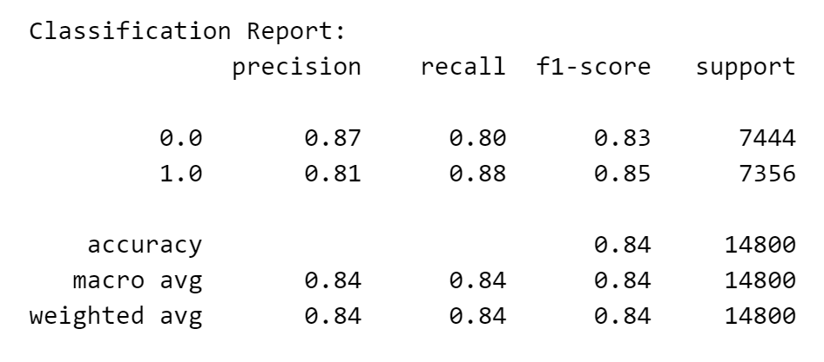
LOGISTIC REGRESSION
XGBOOST

Slide 10

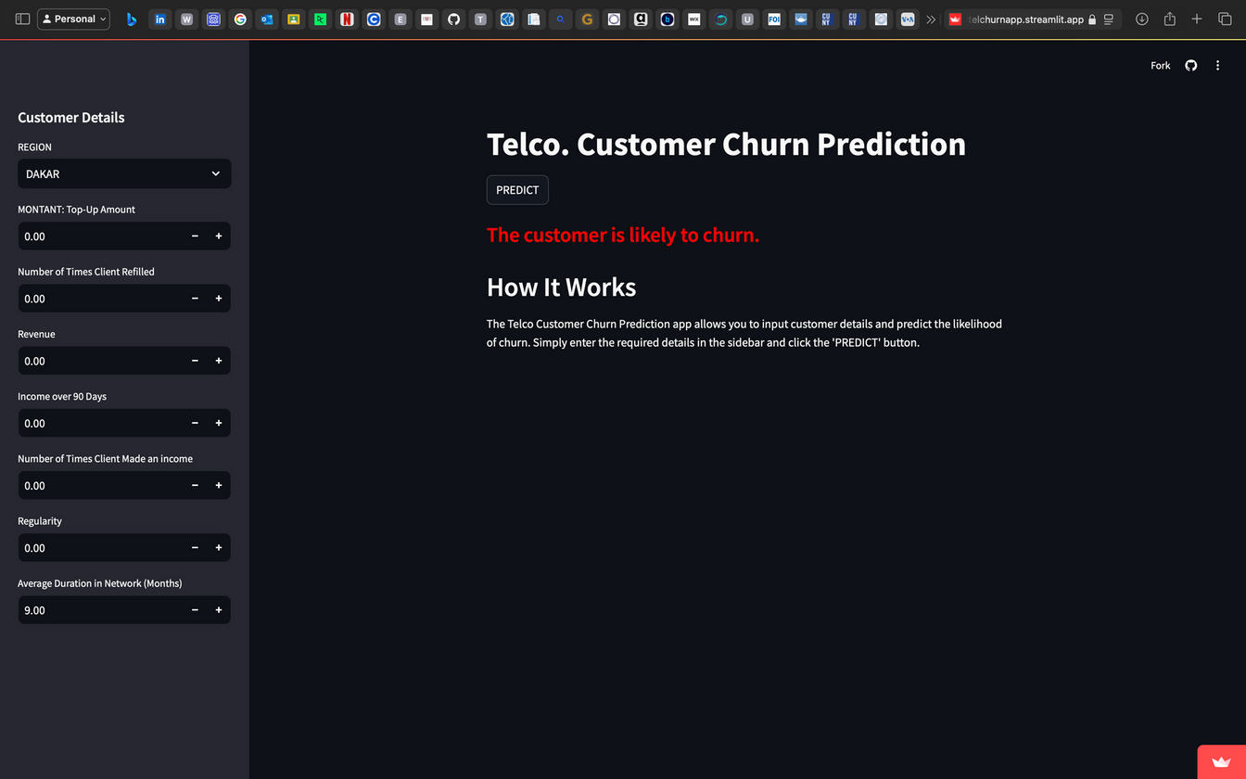
MODEL DEPLOYMENT
link: https://afritelchurnapp.streamlit.app

Slide 11
CONCLUSION

Slide 12


Adopted Model
Future Work
XGBoost Classifier (new_xgb_model.pkl)
Explore the possibility of combining
two or more models in efforts to
improve accuracy.
Neural networks in Predictions
Accuracy score: 84%
Trained on 8 top features from the dataset.
Very good precision for each class
Recommendations
Implement retention strategies in Dakar.
Conduct surveys to collect feedback
From churned customers to understand reasons
Their decision to leave.
Analyze patterns of customer behaviors and predict future churn.

Slide 13
THANK YOU
GROUP MEMBERS
EUGENE TETTEY AYERKAIN
HOCKET APERSIL
IBEKWE FAVOR M.
DACOSTA AGYEI
JULIET OLUSOLA
SARAH KINFUL
CALIS SEYI SAMUEL

